Slide 1
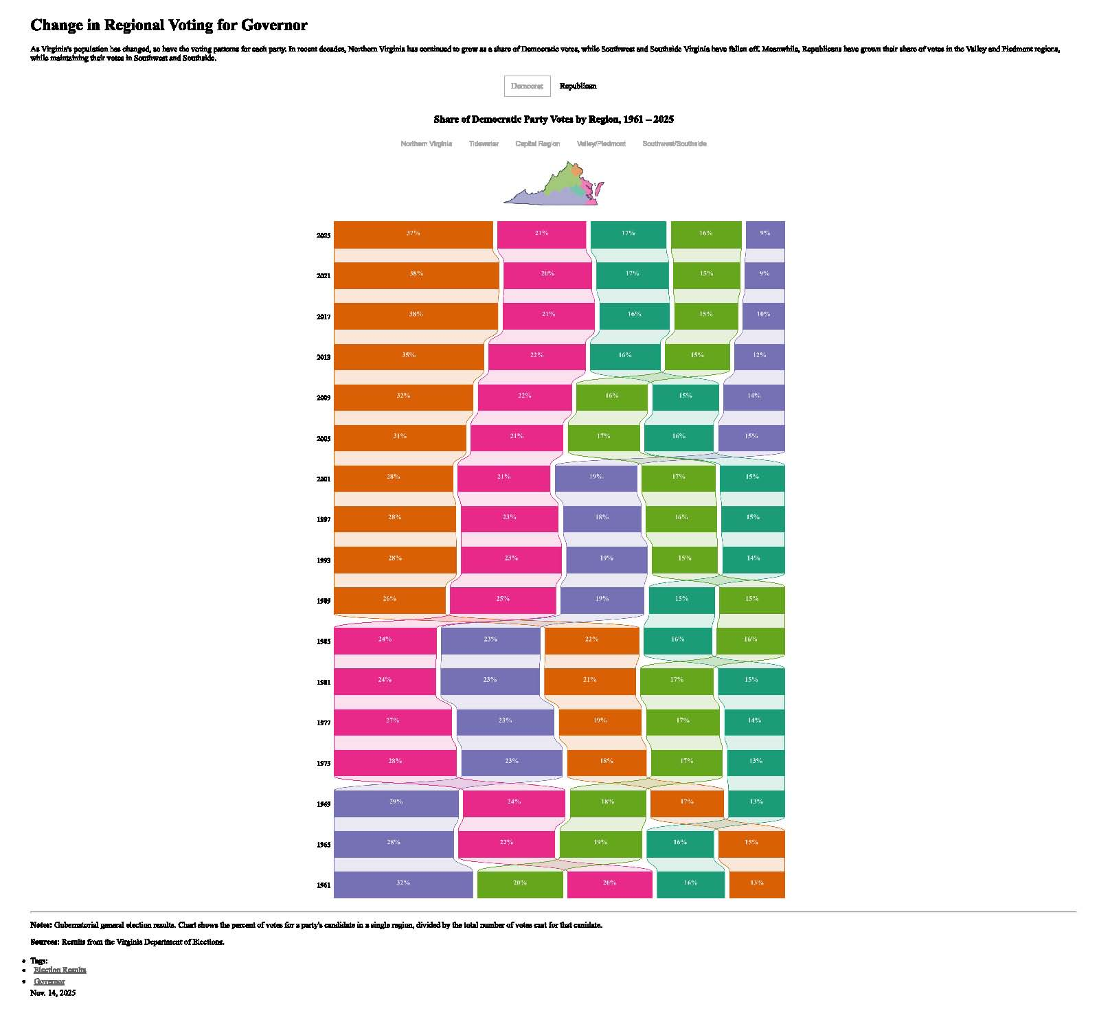
Notes:
I’m not going to overwhelm you with numbers. Rather, this is going to be a graphics show. Just take in the overall picture. This first slide, courtesy of VPAP, tracks the share of Democratic votes in every gubernatorial election since 1961. Virginia is broken into regions, with orange being Northern Virginia, the Piedmont in light green, Tidewater is pink, the Richmond area in dark green, and Southwest/South Side in blue. Each horizontal bar represents 100% of the Democratic vote in each election. So, in the 1961 election, the last before the passage of the Voting Rights Act, when Virginia was part of the Solid South, southern Virginia contributed 32% of the Democratic votes, with Piedmont second at 20%. In election after election, Piedmont and the Southwest have contributed less and less than the other regions until this year, when Northern Virginia constituted 37% of the democratic vote and the Piedmont gave only 17%.

Slide 2
Notes:
Since 2015, the number of active voters in Virginia has increased by about 11%. Culpeper County’s voters have increased more than twice as fast at 24%.

Slide 4
Notes:
These charts show Republican vs Democratic votes in the county every year over the past decade. 2015 is an outlier year because the Republican candidate for delegate was unopposed. Note that the percentage of red vs blue votes has remained pretty consistent at about 60%-40% despite the increase in the number of voters. The notable exception is 2021, when Glenn Youngkin delivered a heavier than normal wallop to Terry McCauliffe.

Slide 5
Notes:
In this year’s race, there wasn’t any significant undervoting down ballot on the Democratic side (governor and delegate votes were nearly identical across precincts. It is interesting to see that on the Republican side, there were more votes for delegate than there were for governor. Of importance is the chart on the right side. “Town” districts are blue, and rural districts are green. The percent voter turnout in town districts is consistently lower than in rural districts. Since town districts are the more strongly Democratic, higher turnout could mean more Democratic votes.

Slide 6
Notes:
What we see in state races is mirrored in federal elections. This is the most recent midterm election, the last one that Abigail won. Town districts didn’t turn out to vote at the same rate as the rural districts.

Slide 7
Notes:
Here are the results of the nonpartisan local races. Keith Farrish won in Jefferson, Mandy Brown in Cedar Mountain, and Dewayne Payne in Stevensburg. The school board candidates all ran unopposed.

Slide 8
Notes:
Frank Reaves was reelected as mayor by a comfortable margin, and the four top vote getters for town council were Bill Yowell, Janie Schmidt, Joe Short, and Max Sternberg.

